Slide 1
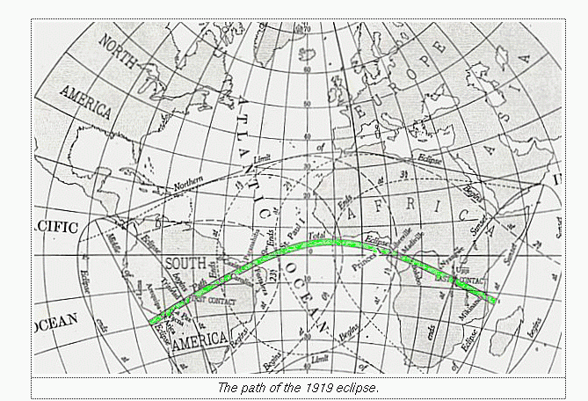
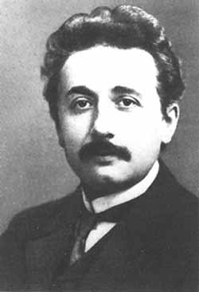
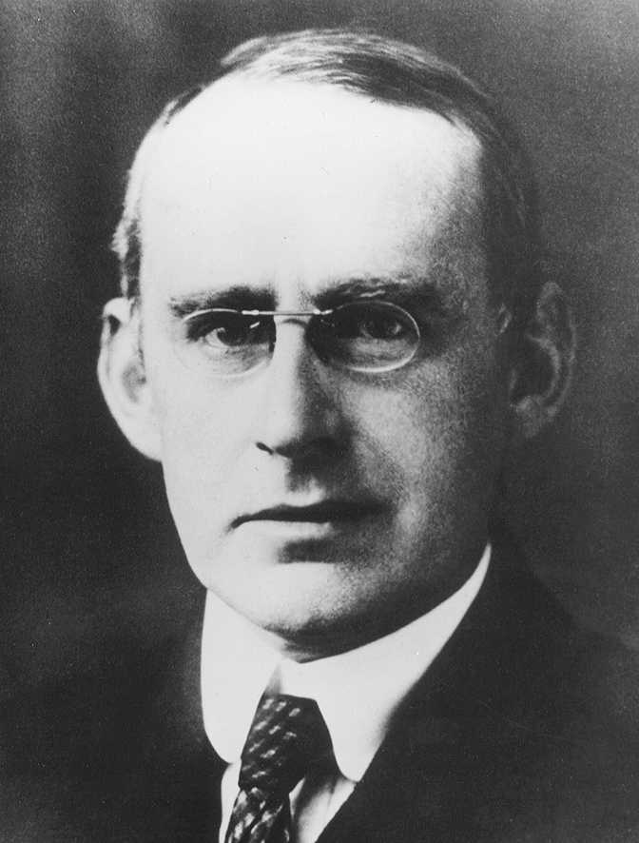
Ninety Years of Gravitational Lensing: A Pilgrimage to `Eddington’s Island’

Slide 2
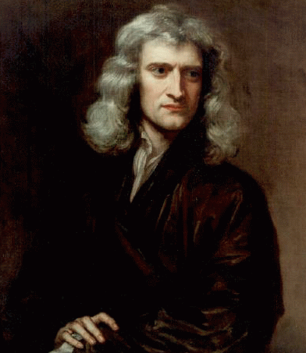
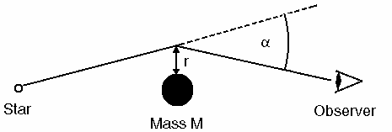
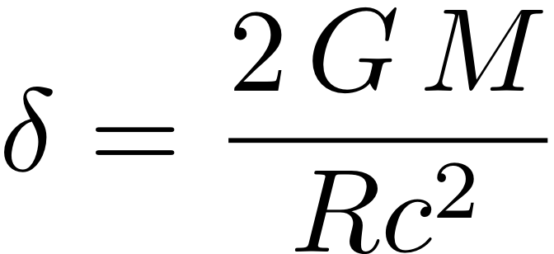
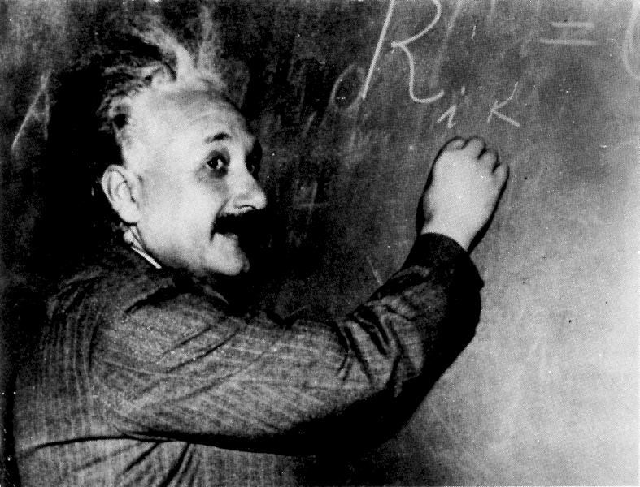
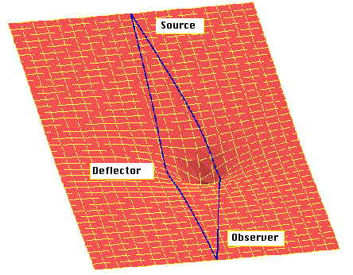
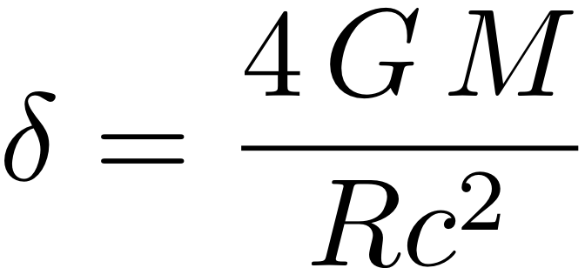
Deflection of Light by Mass
Isaac Newton (1704) “Do not Bodies act upon Light at a distance, and by their action bend its Rays; and is not this action strongest at the least distance?”
Henry Cavendish (1784, unpublished) – calculates deflection due to hyperbolic trajectory assuming light is corpuscular
Johann von Soldner (1804) – publishes same calculation and derives 0.84 arcsec
Einstein (1911) – relativistic version of Newtonian deflection 0.875 arcsec (classical result assumed light can be accelerated/decelerated like matter)
Einstein (1915) – GR version includes curvature of space, 1.75 arcsec

Slide 3
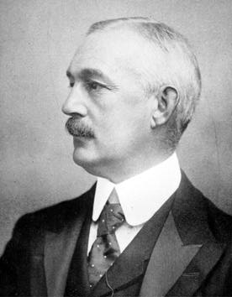
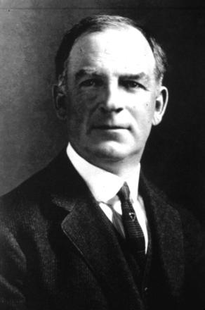
Eclipses Before 1919 – a Sorry Tale
Einstein finds assistant observer – Eirwin Findlay-Freundlich who tries for ten years to measure the deflection & never succeeds!
Einstein writes to Hale inquiring whether deflection could be detected via Jupiter (see Huntington `Beautiful Science’ exhibition)
William Wallace Campbell (Director, Lick) races with Findlay-Freundlich to prove/disprove Einstein.
US community remains very skeptical of GR through late 1920’s
Aug 21 1914 Eclipse:- war breaks out week of eclipse!
Campbell’s equipment in Russia impounded
Findlay-Freundlich arrested in Turkey
June 8 1918 Eclipse
Campbell clouded out in Washington State

Slide 4
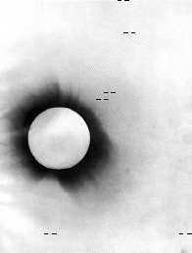
Solar Eclipse of 29 May 1919
Remarkable opportunity as Sun is in the rich Hyades star cluster
British send two expeditions to Sobral, Brazil and Principe, W Africa
Path of totality
Frank Dyson (Astronomer Royal) recognizes the opportunity
Eddington is however driving force as he is inspired by Einstein’s theory
Eddington leads expedition by going to Principe

Slide 5
The unexpected hero: Arthur Eddington
When the eclipse expedition is planned, Britain is at war with Germany
Contact between Eddington and Einstein would be a `treasonable act’
Eddington learns of GR via de Sitter and is inspired to verify or disprove it
Eddington is a pacifist and a Quaker and is only rescued from military service by leading the expedition
The war ends 6 months before the eclipse

Slide 6
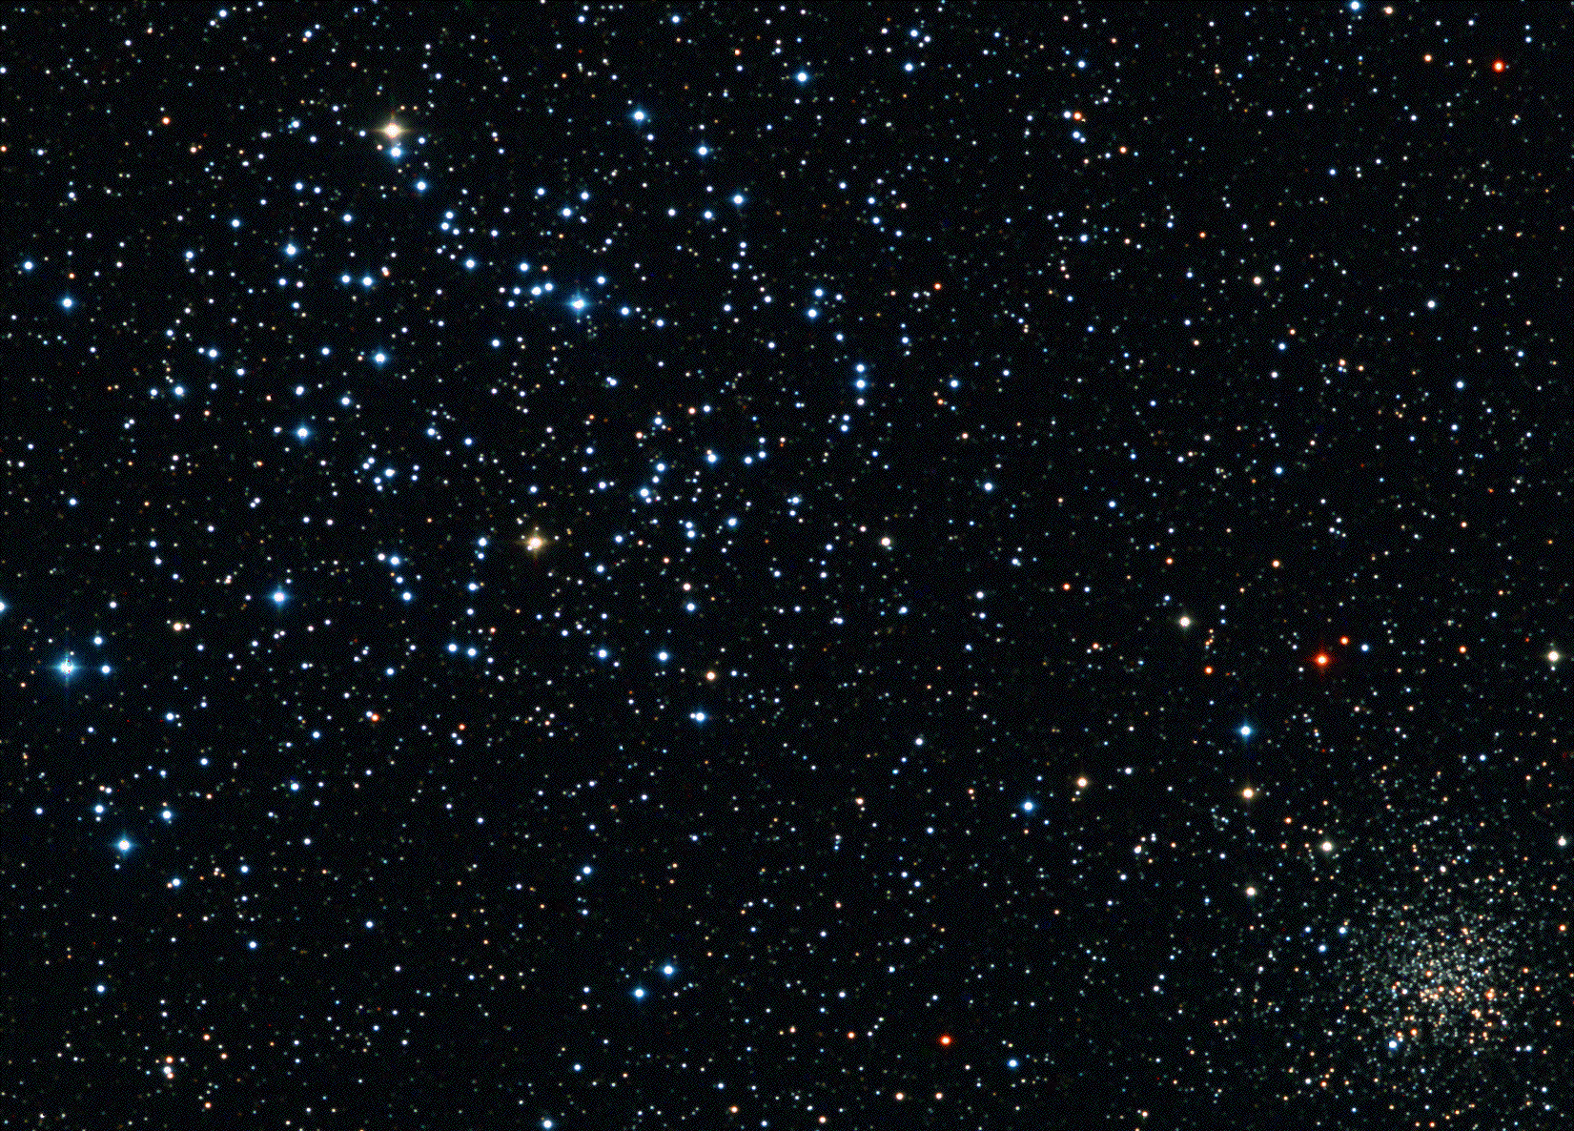
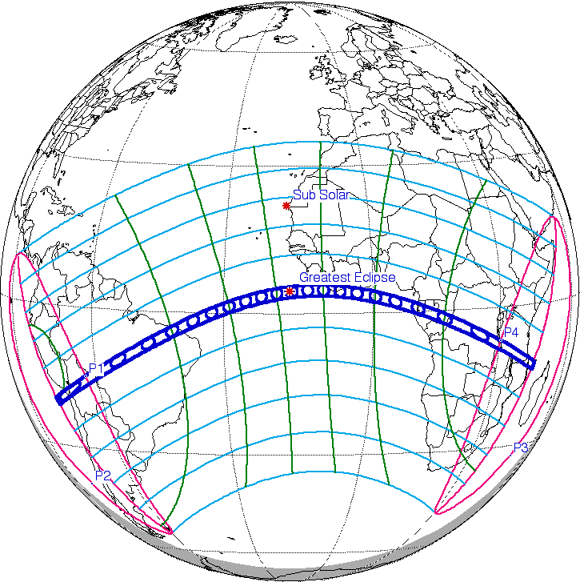
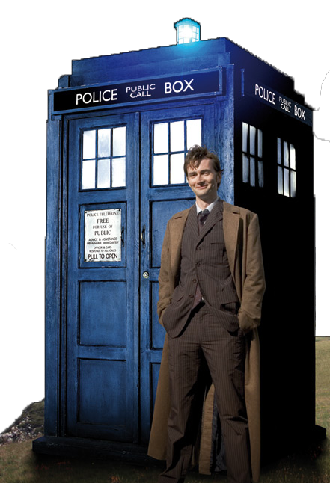
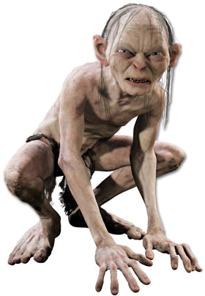
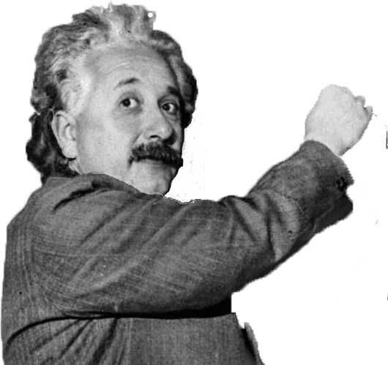
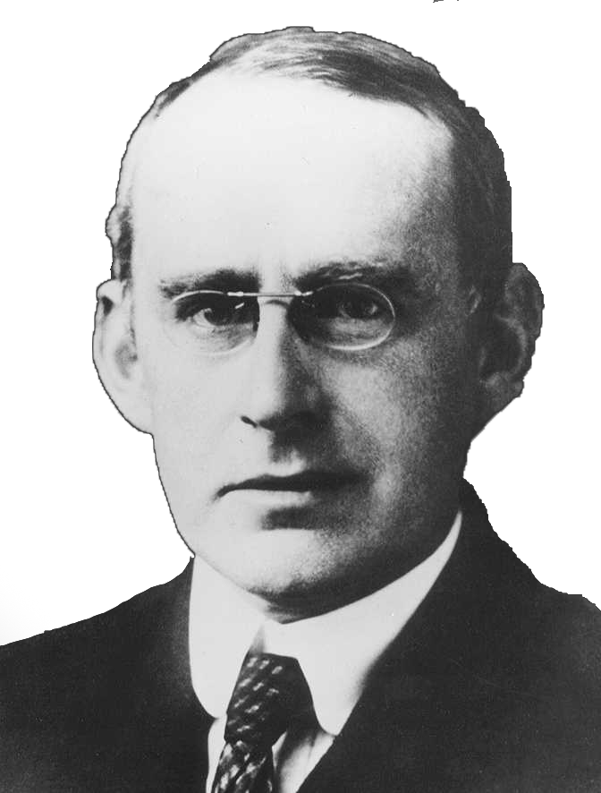
BBC Dramatization “Eddington and Einstein”

Slide 7
Was Eddington Biased in His Analysis?
Eddington was clearly inspired by Einstein’s theory
He considered his verification of the deflection `the greatest moment’ of his life
Yet the deflection results from Sobral and Principe were at first sight discrepant and needed careful treatment
Some consider he was so sure of the result that he discarded discrepant data so as to verify Einstein
e.g. John Waller (2002) Fabulous Science “a series of famous scientists whose passion and belief in a theory blinded them to contrary evidence” (including Millikan!)
Read Daniel Kennefick’s excellent analysis on astro-ph/0709.0685
(see also Physics Today March 2009 p37)
Conclusion: Eddington was a man of principle and did not fudge his data!

Slide 8
Kennefick’s Case in Support of Eddington
Principe : Eddington & Cottingham:
Astrograph: only 2 plates, 5 stars on each
Comparison plates taken at Oxford in February 1919
Analysis gave = 1.61 ± 0.30 arcsec
Sobral: Crommelin & Davidson
Astrograph: several plates, 12 stars on each but out of focus!
Comparison plates taken later in situ
Analysis gave = 0.93 ± ? arcsec
4-inch lens: much smaller field but in focus
Comparison plates taken later in situ
Analysis gave = 1.90 ± 0.11 arcsec
Some argue Eddington discarded the Sobral astrograph to match GR prediction
Actually it was not Eddington but Dyson who discarded those data
Dyson did a further analysis of the Sobral astrograph assuming focus change did not affect the plate scale and got = 1.52 arcsec
1979: Sobral plates were re-measured via machine: = 1.55 ± 0.32 arcsec

Slide 9
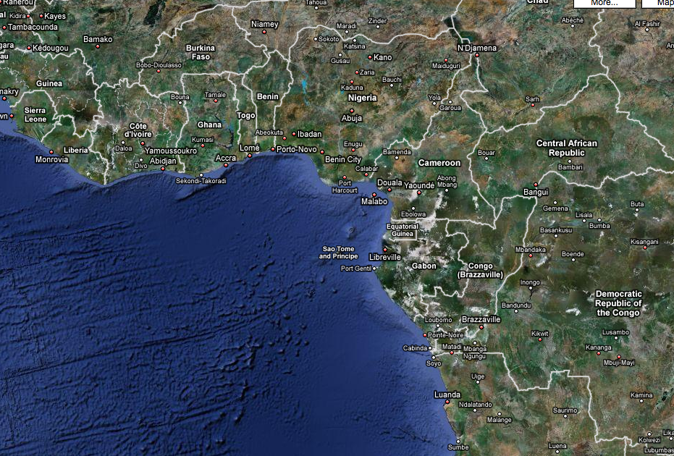
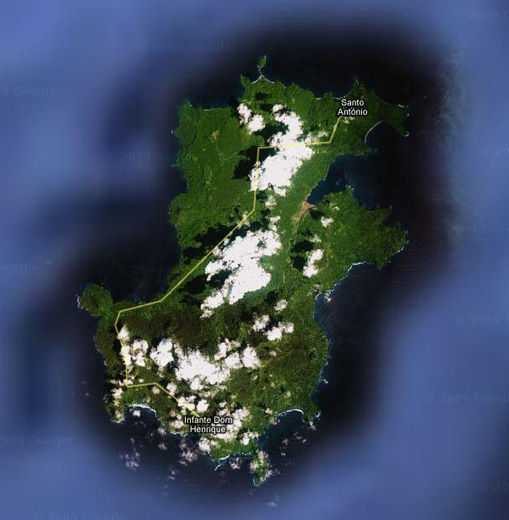

Slide 10
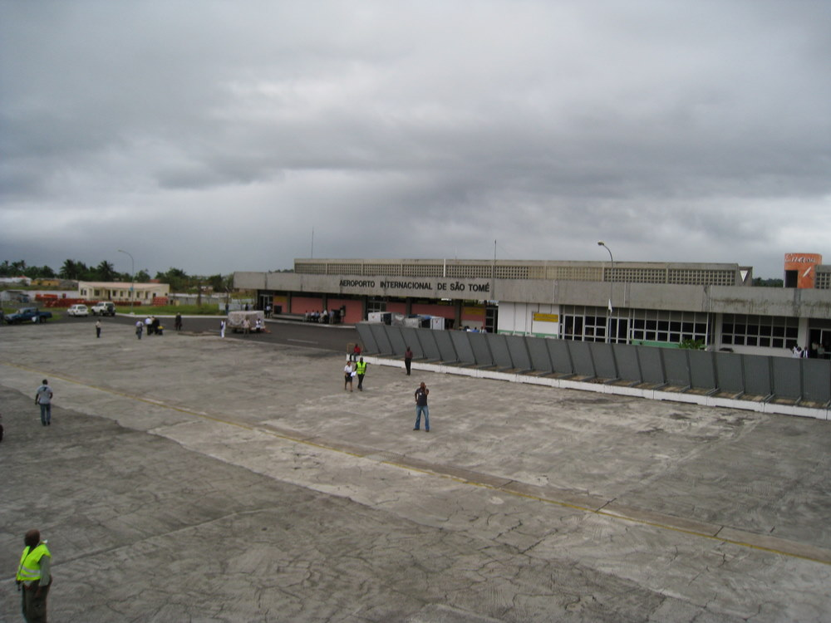

Slide 11
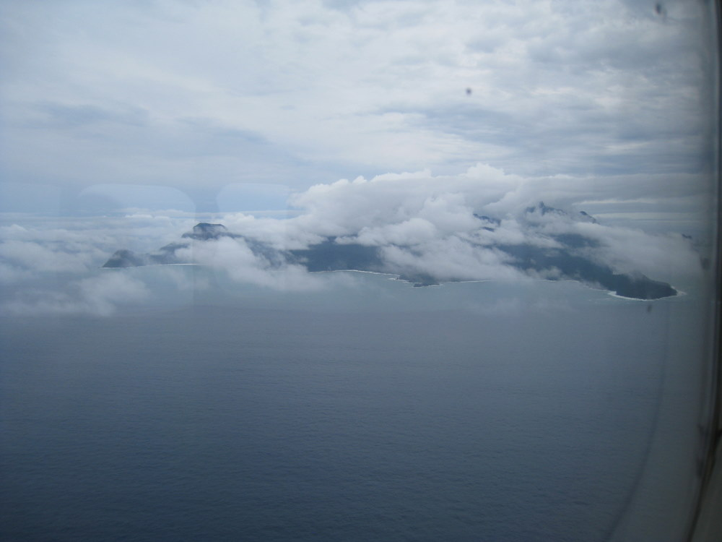

Slide 12
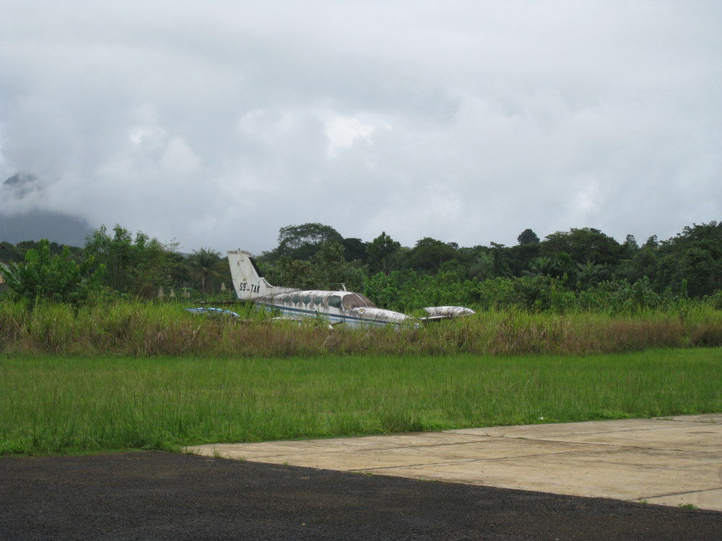

Slide 13
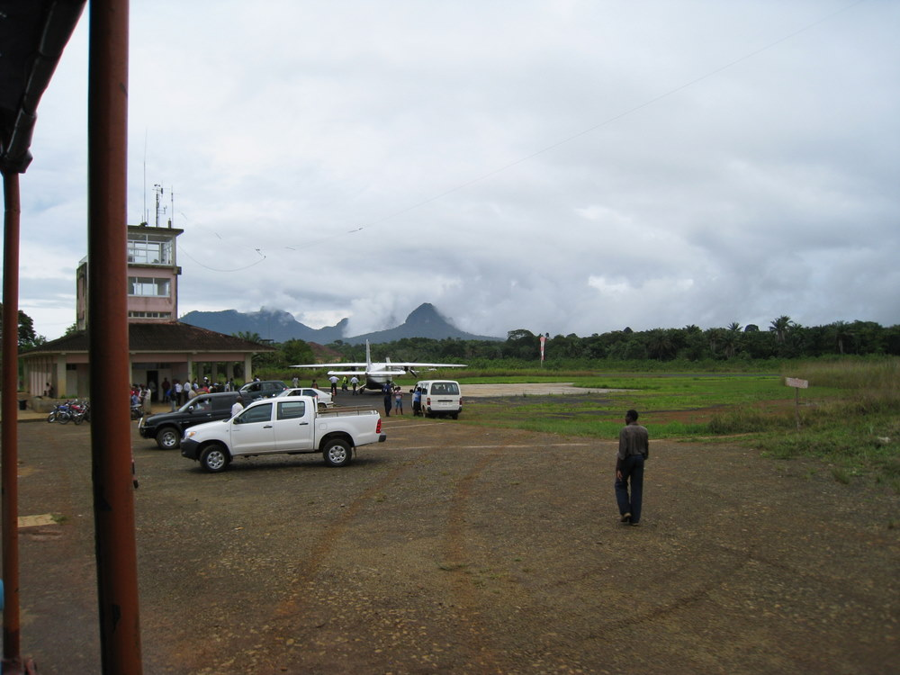

Slide 14
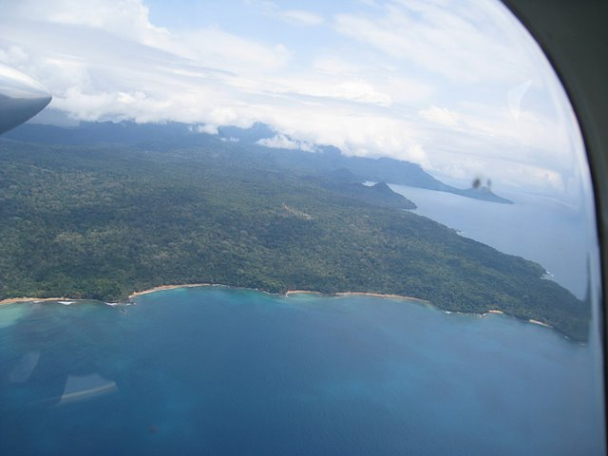
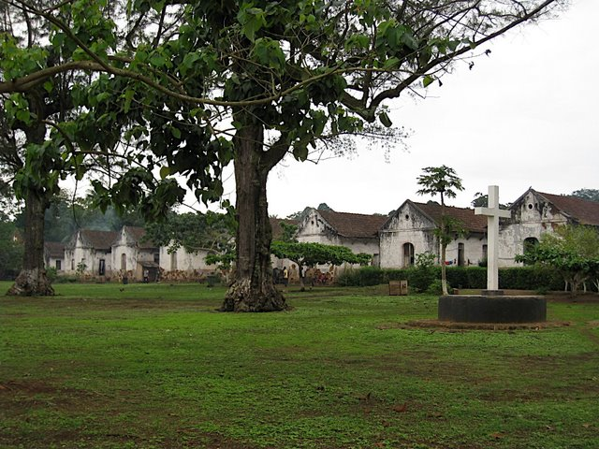
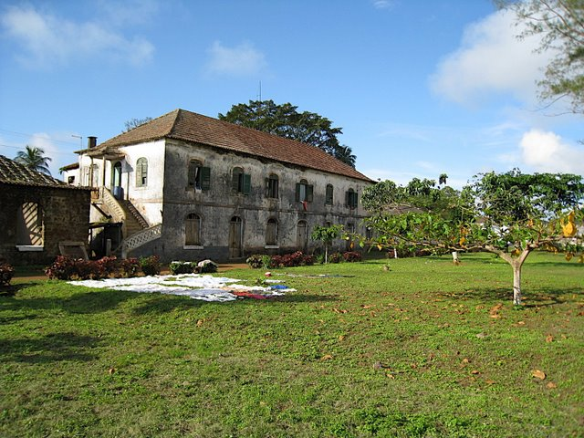

Slide 15
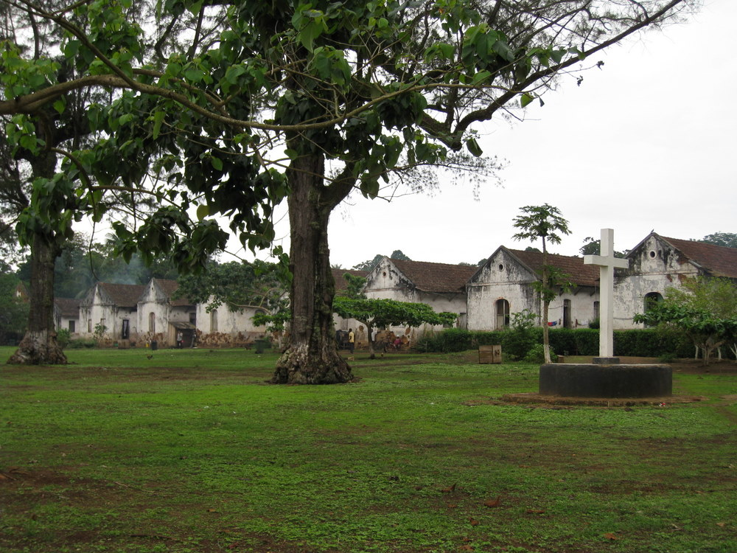

Slide 16
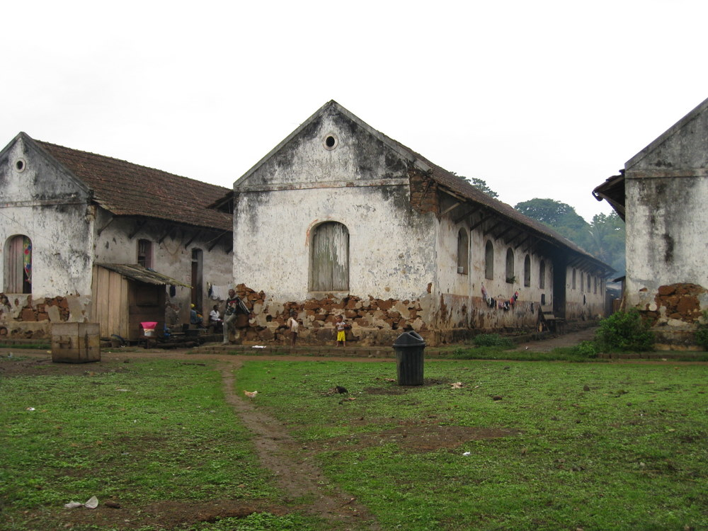

Slide 18
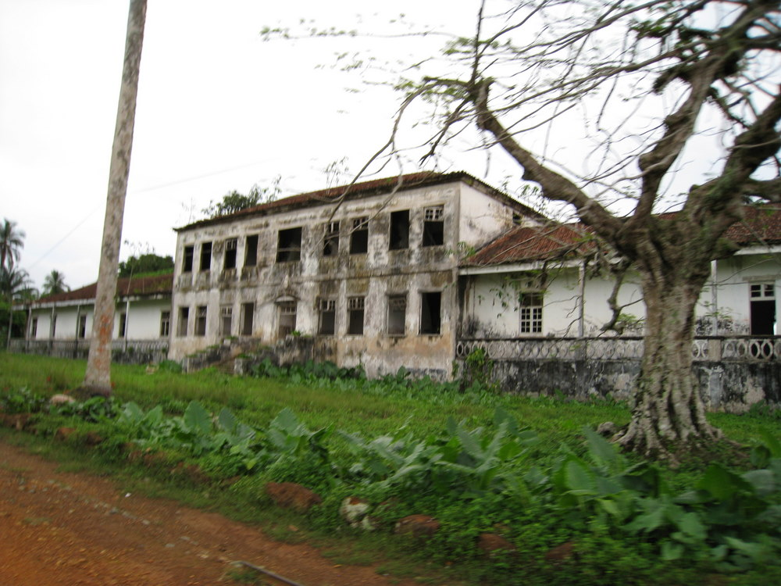

Slide 19
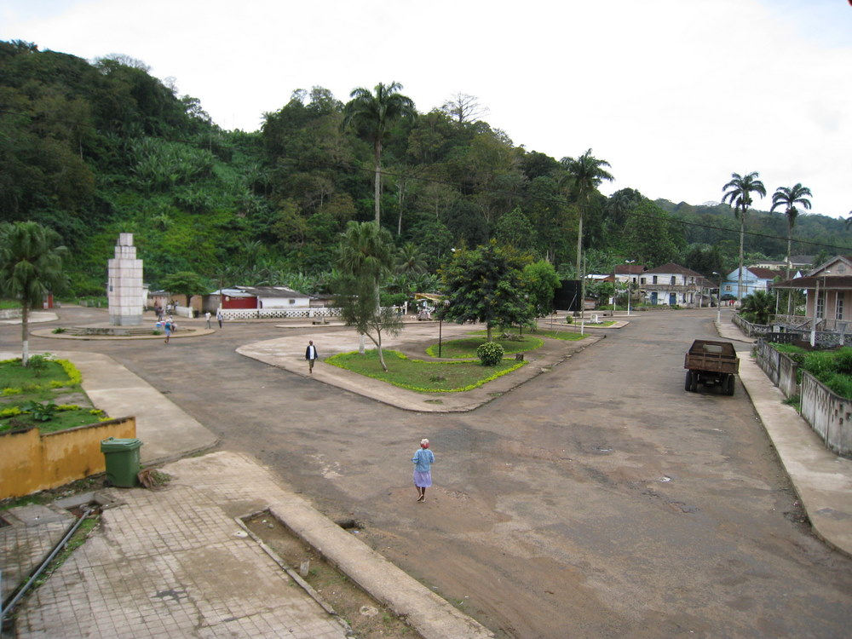

Slide 21
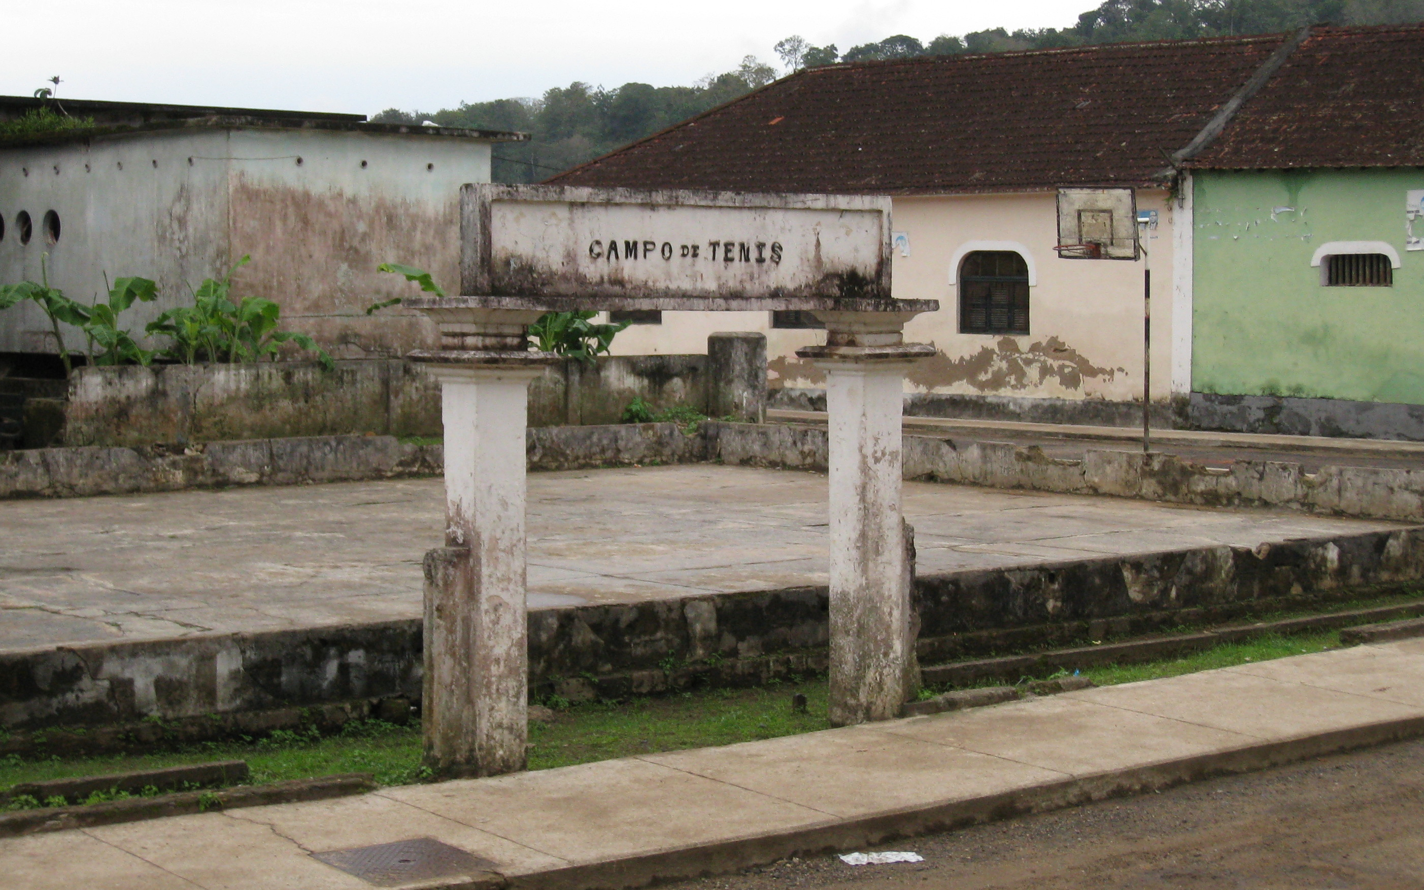
At four o’clock that afternoon we both played tennis with the Curador and the Judge. We had three very good sets and enjoyed the games very much. The court was on asphalte. There is no one else who plays tennis on the island now, so I think the other two were very glad to have the game—the Judge especially seemed to enjoy himself. I expect we shall get some more games when we return to the city.² (We always call it the city—but S. Antonio is only a tiny village.)

Slide 22
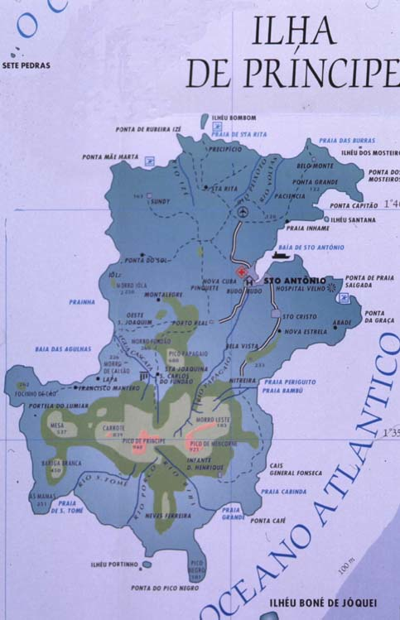
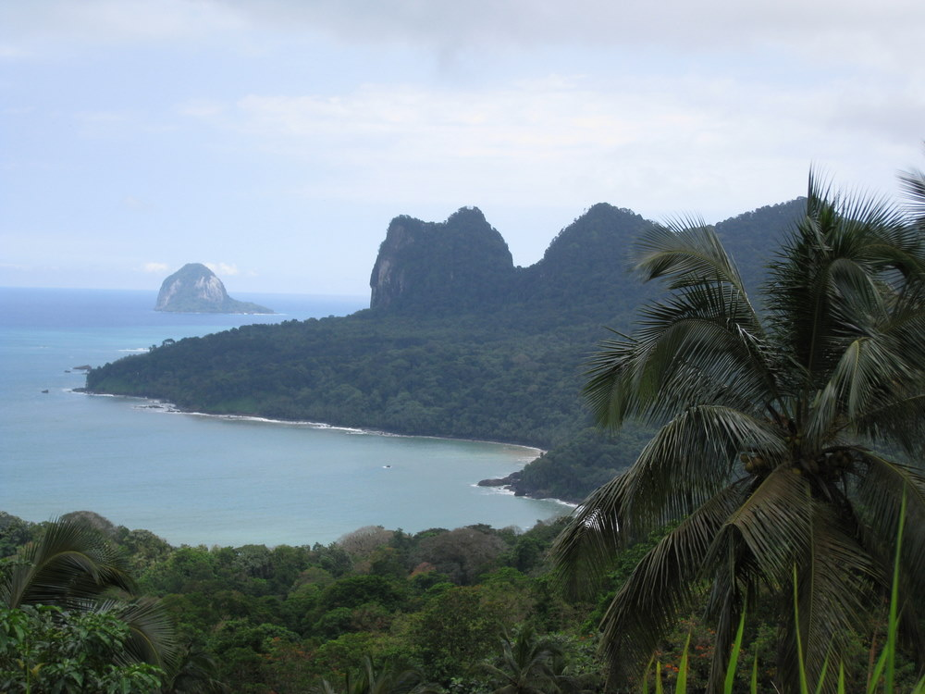

Slide 23
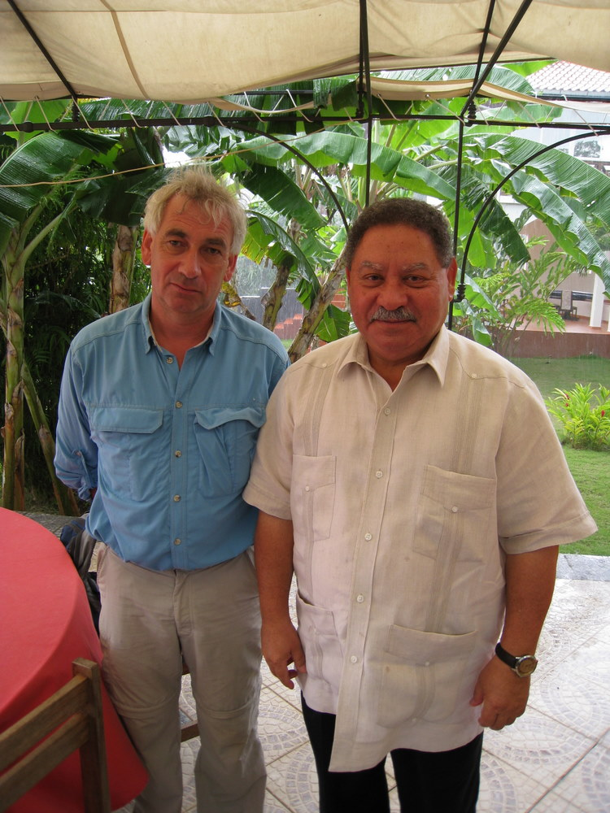

Slide 24
IYA2009 90th anniversary celebration
(www.1919eclipse.org)
Return expedition:
Installing a commemorative plaque
Public lectures (in Portuguese)
Exhibition on the history of lensing
Sadly no eclipse on cue….
Sponsored by RAS, IAU, Sao Tome & Principe government

Slide 26
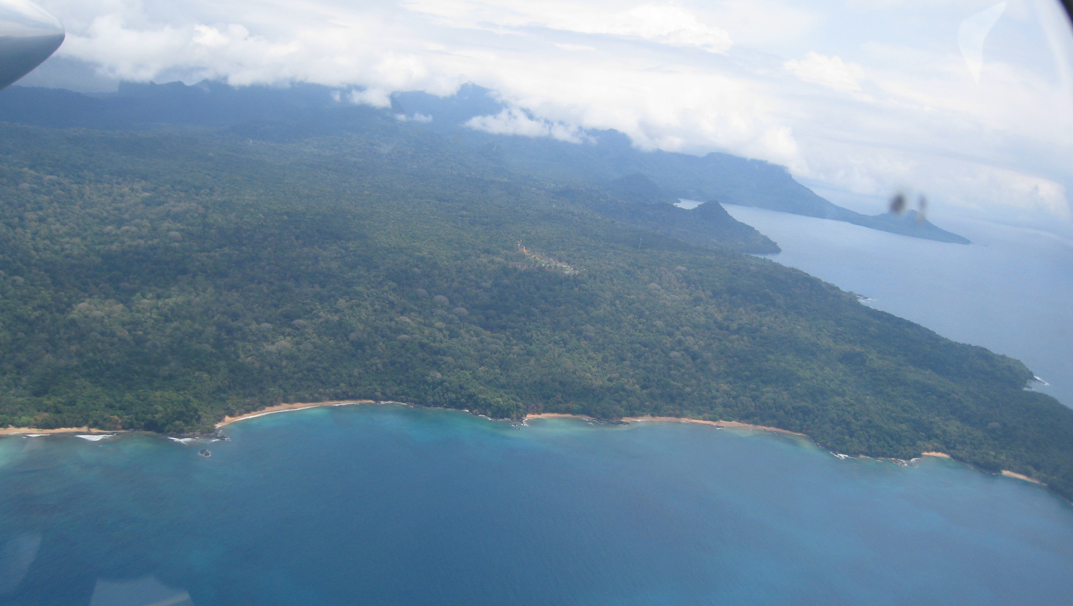
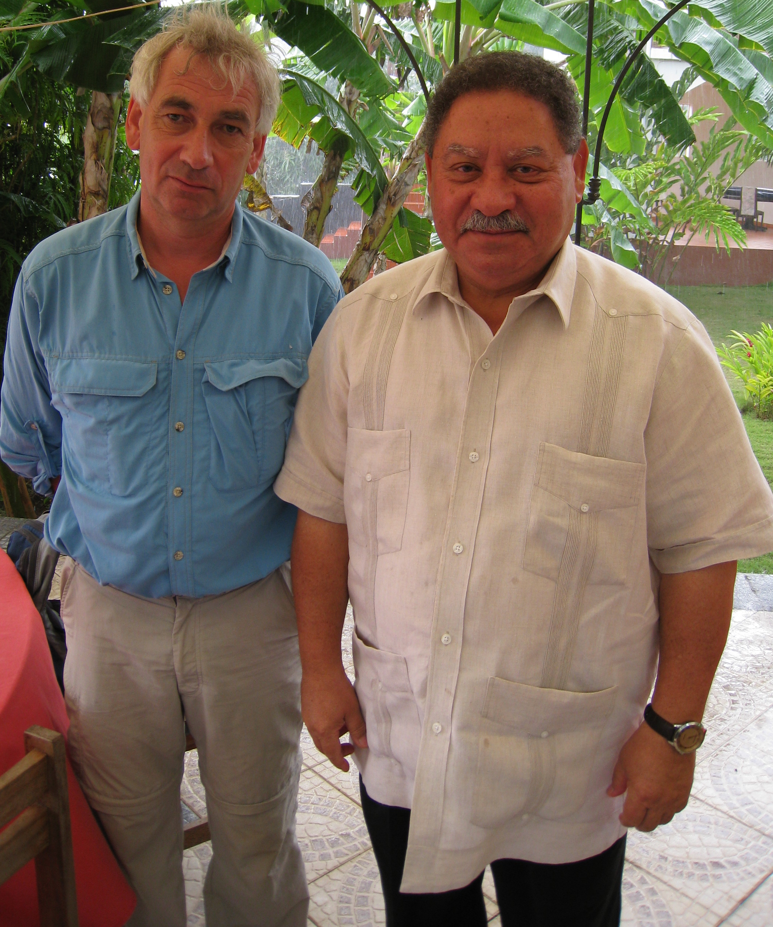
Pilgrimage to Principe: September 2008

