Slide 1
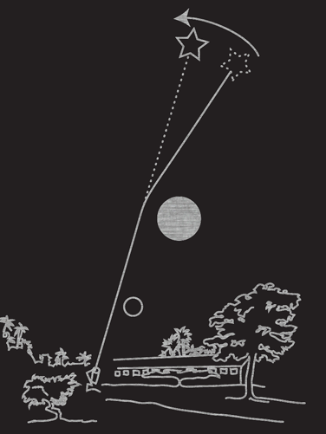
Nine decades of gravitational lensing
Richard Massey
Royal Observatory Edinburgh
Isaac Newton (1704) – “Do not Bodies act upon Light at a distance, and by their action bend its Rays; and is not this action strongest at the least distance?”
Henry Cavendish (1784, unpublished) – Calculates deflection of a hyperbolic trajectory assuming light is corpuscular.
Johann von Soldner (1804) – Publishes same calculation, derives 0.84”.
Einstein (1911) – Relativistic version of Newtonian deflection 0.875” (classical result assumed light can be accelerated/decelerated like matter).
Einstein (1915) – GR version includes curvature of space, 1.75”.
Notes:
Aug 21 1914 Eclipse:- war breaks out week of eclipse!
Campbell’s equipment in Russia impounded
Findlay-Freundlich arrested in Turkey
June 8 1918 Eclipse
Campbell clouded out in Washington State

Slide 2
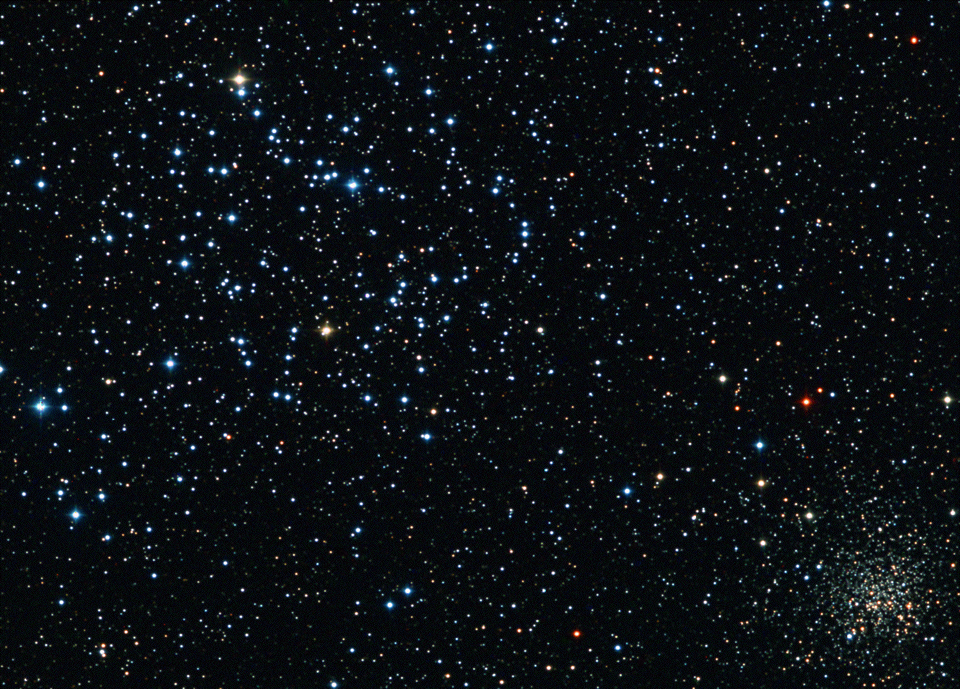
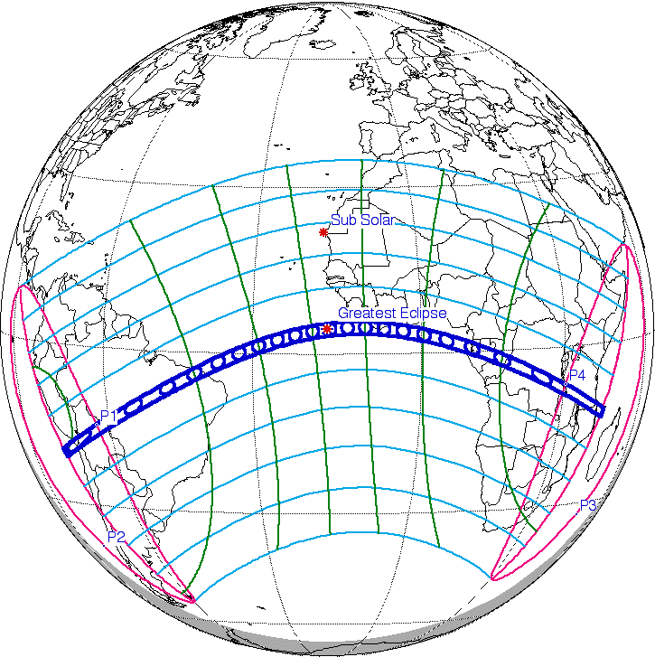
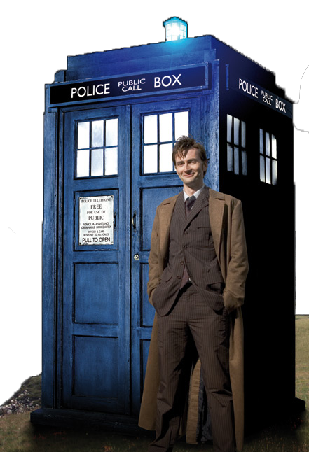
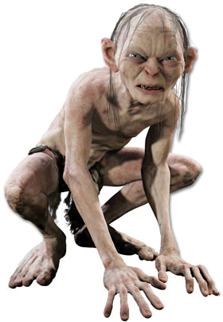
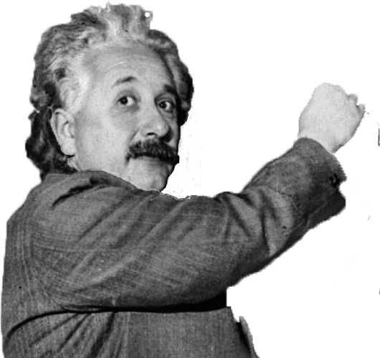
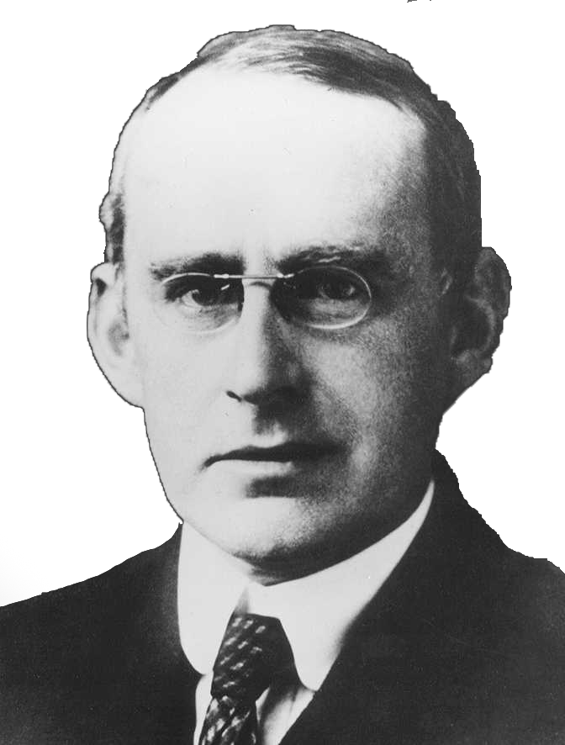
The total solar eclipse of 29 May 1919

Slide 3
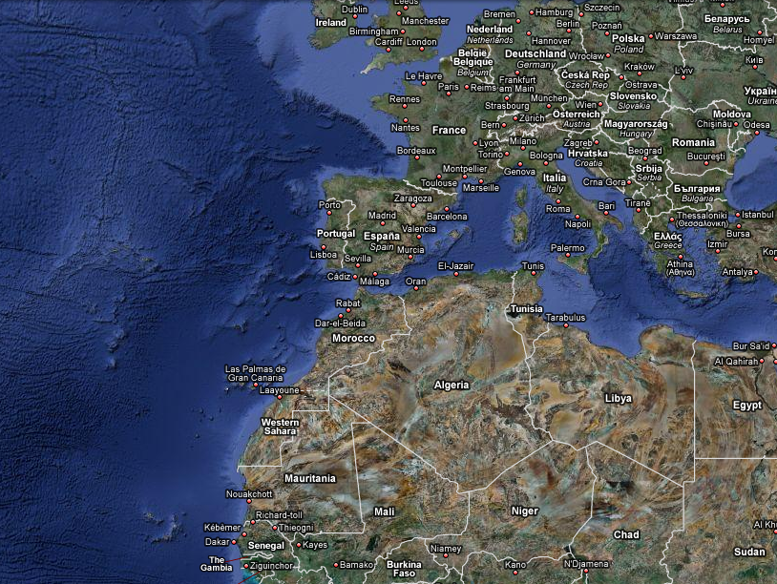
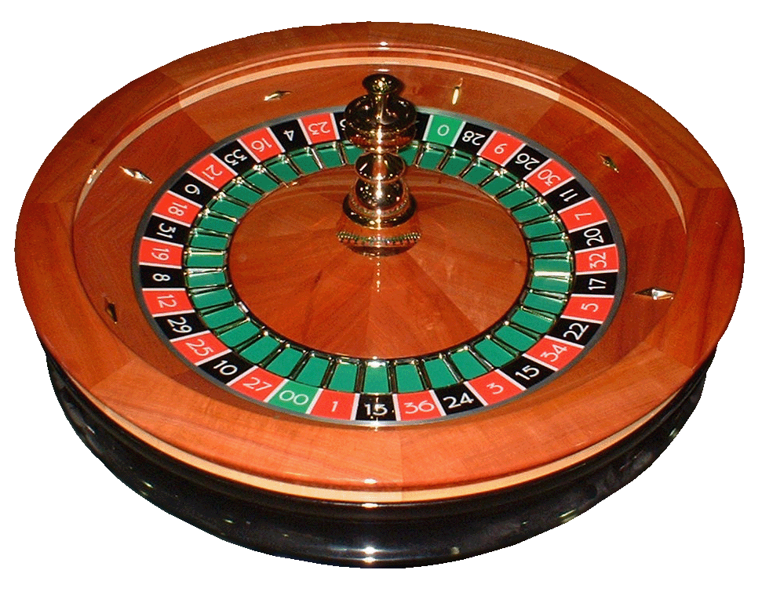
Journey - Europe

Slide 4
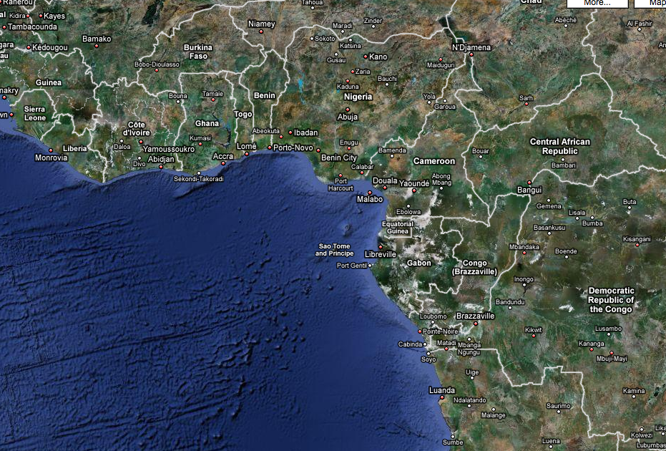
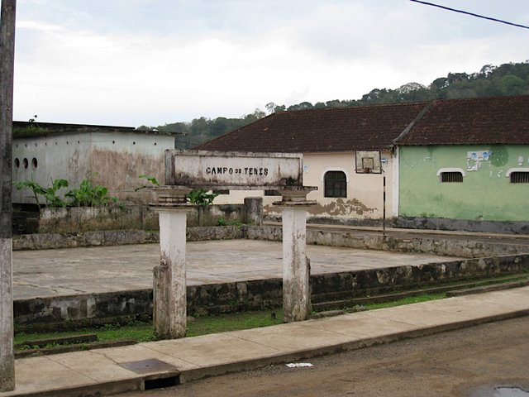
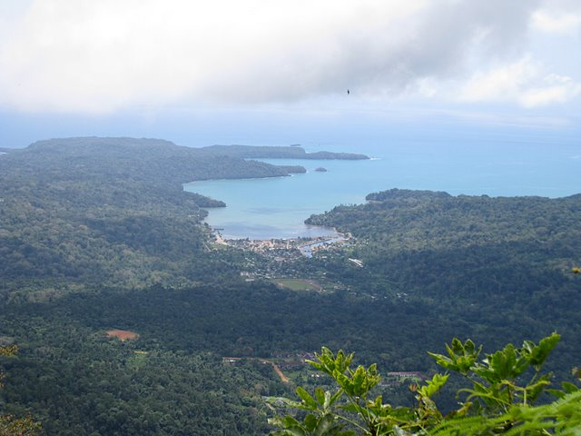
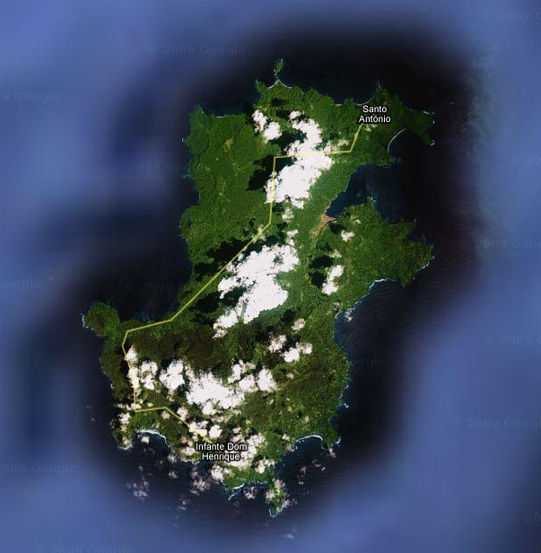
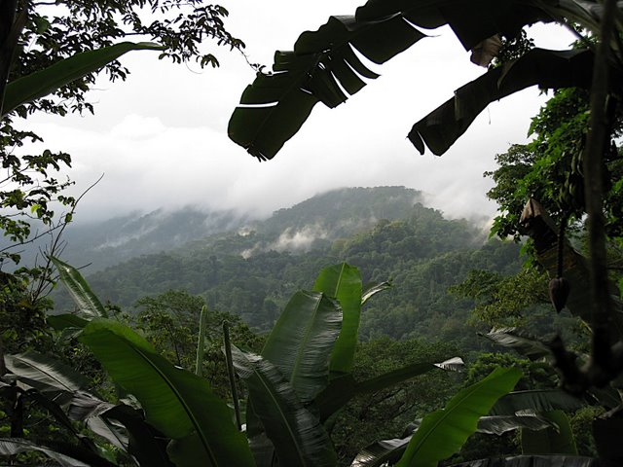
Journey - Africa

Slide 5
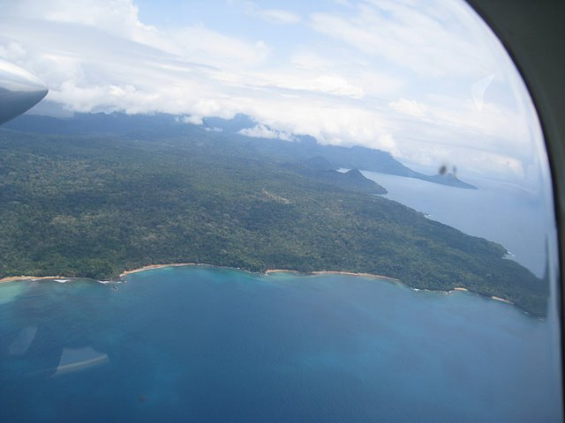
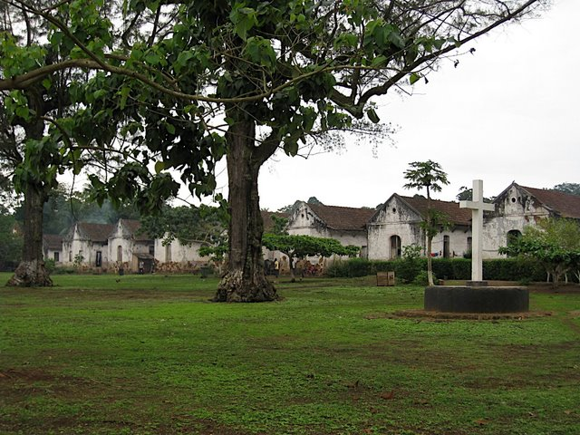
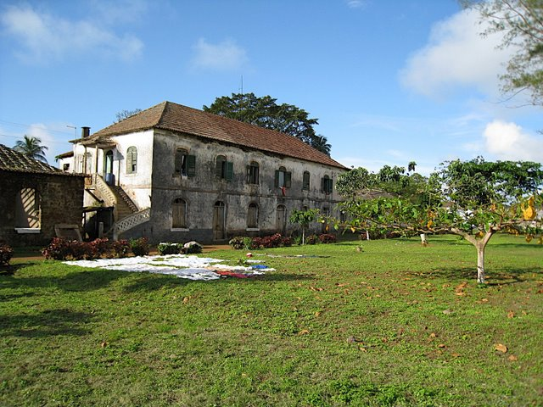
Roca Sundy plantation

Slide 6
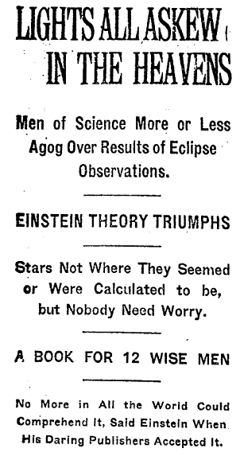
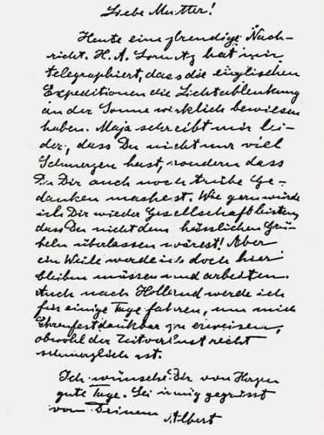

Slide 7
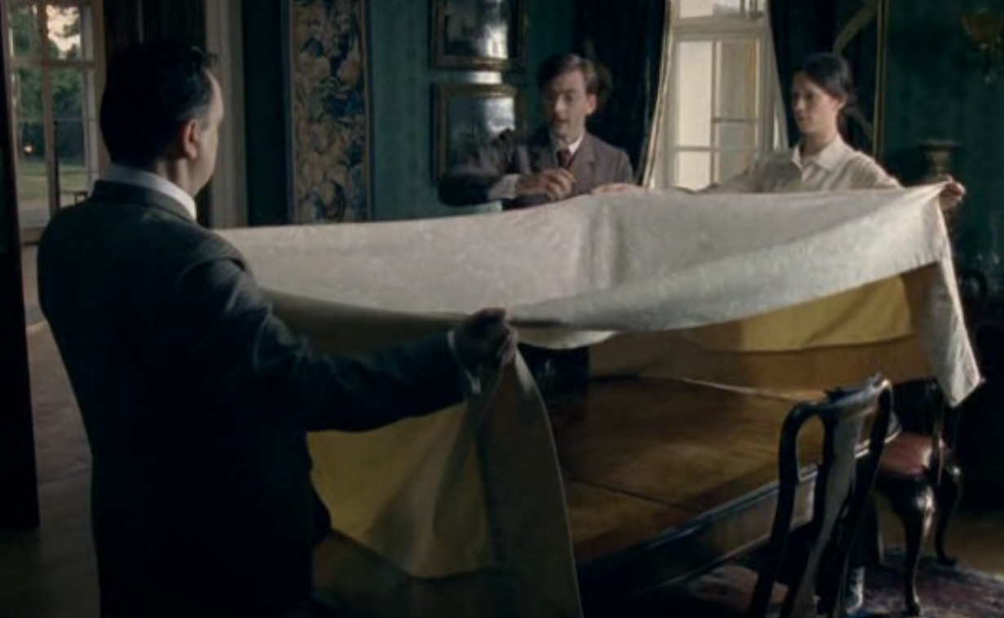
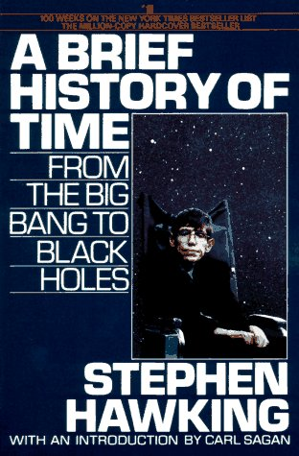
Curved space

Slide 8
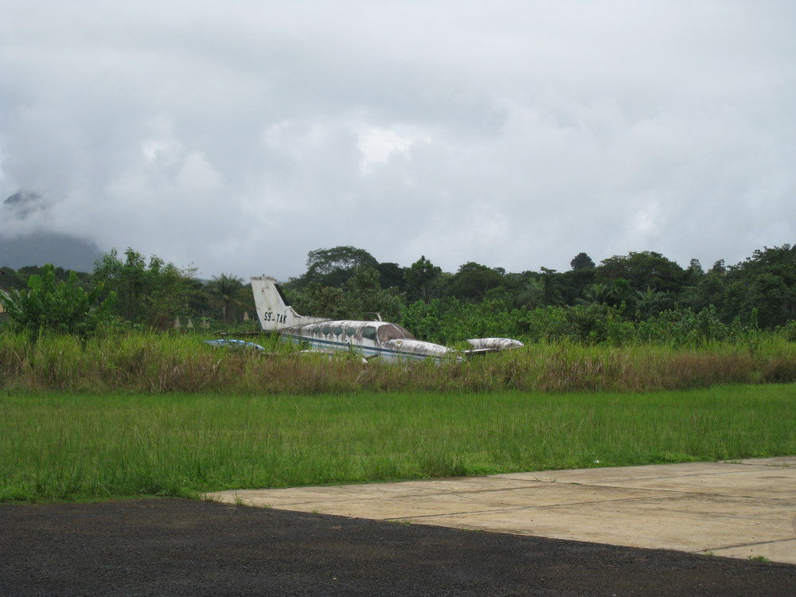
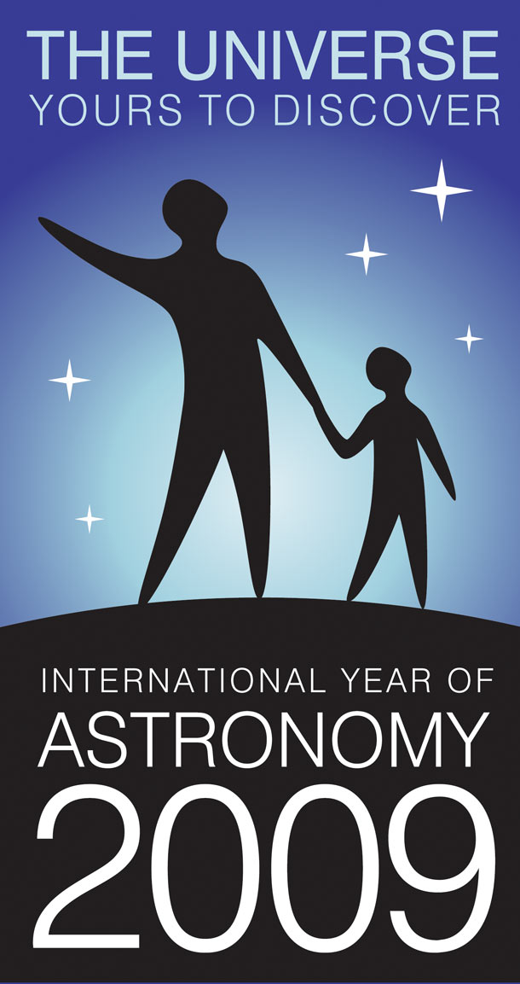
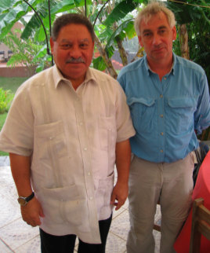
IYA2009 90th anniversary celebration
(www.1919eclipse.org)
Return expedition:
Installing a commemorative plaque
Public lectures
Exhibition on the history of lensing
Sponsors:
RAS, IAU, Gulbenkian foundation, Portuguese ministry of science

Slide 9
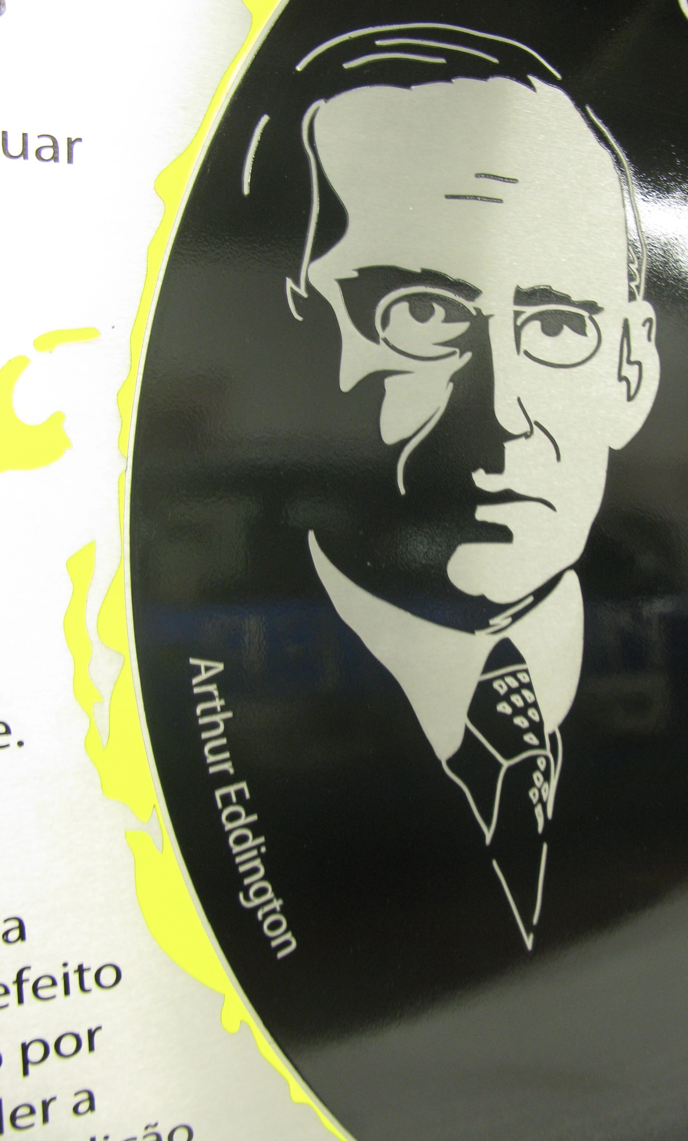
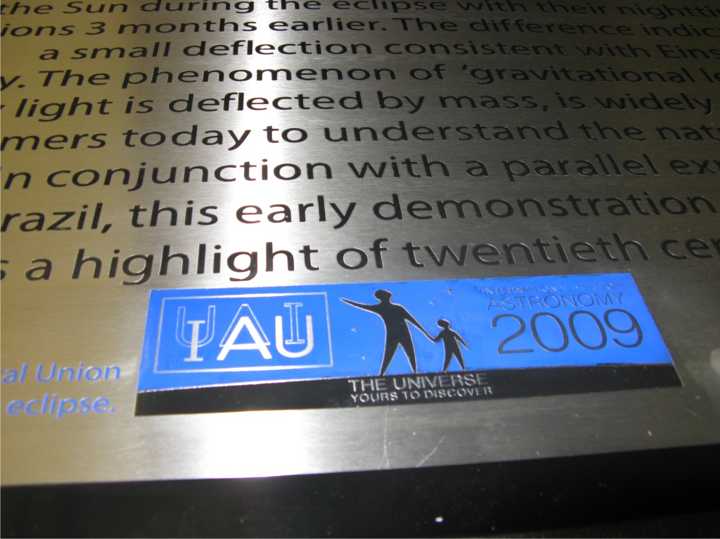
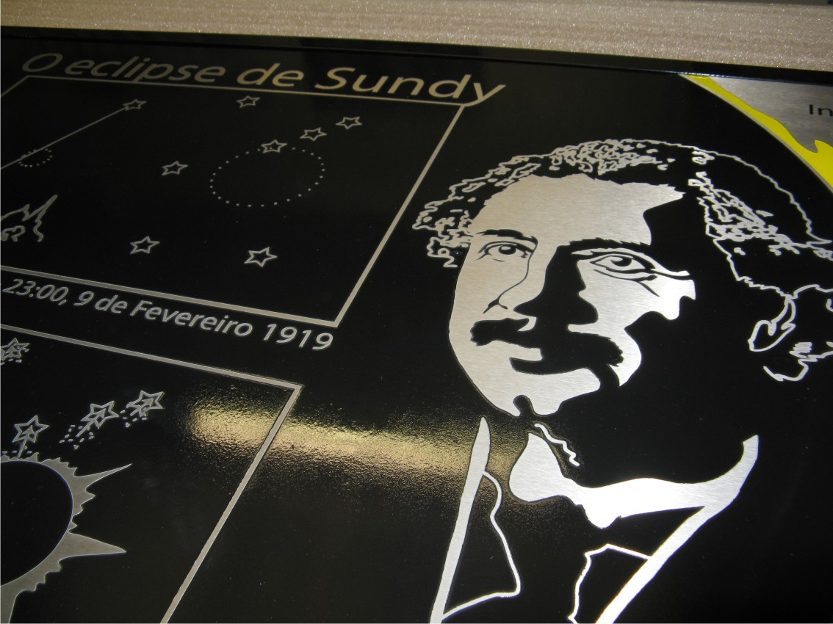
Zoom image of centre of plaque

Slide 10
Zoom image of centre of plaque

